Slide 1

Introduction to Shiny
DSLA Course
Rohit Padebettu

Slide 2





Machine Learning
examples
label₁
label₃
Labeled
Examples
Predicted Label
Data
Model
label₄
label₅
New Unlabeled Data
How do we access it?

Slide 3
Target Skill # 5
Persuasive Communication

Slide 4
Target Skill # 6
Translation
Analytics to Business

Slide 5
Target Skill # 7
Selling your Ideas

Slide 6
Target Skills
Conceptualization
Iterative Problem Solving
Creative Problem Solving
&
Divergent Thinking
Persuasive Communication
Translation
Analytics to Business
Effective Collaboration
Selling your Ideas

Slide 7
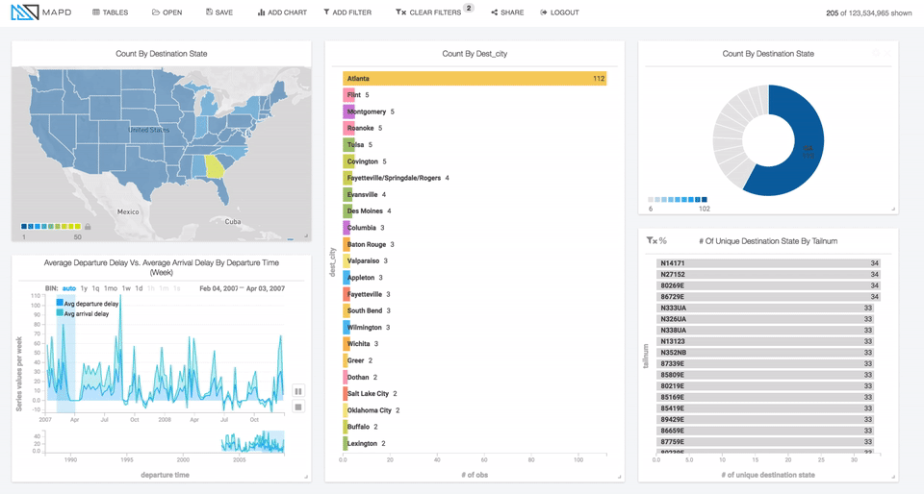
Data Visualization
It is super-duper important !
Data Visualization is basically the
key deliverable
It allows business people to understand data scientists’ work AND what their final recommendations are

Slide 8
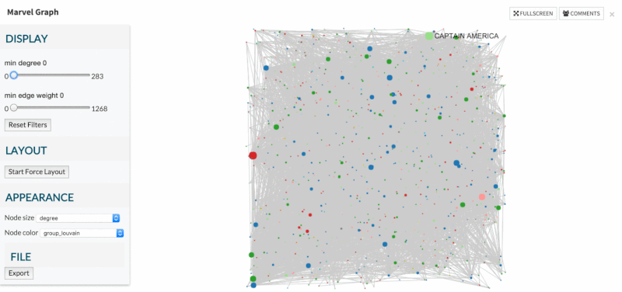
Data Product - Dashboards
It is the only thing more important than Data Visualization
Dashboards
are
Extreme Data Visualization
They allow business people to understand AND play with data to extract information they need

Slide 9
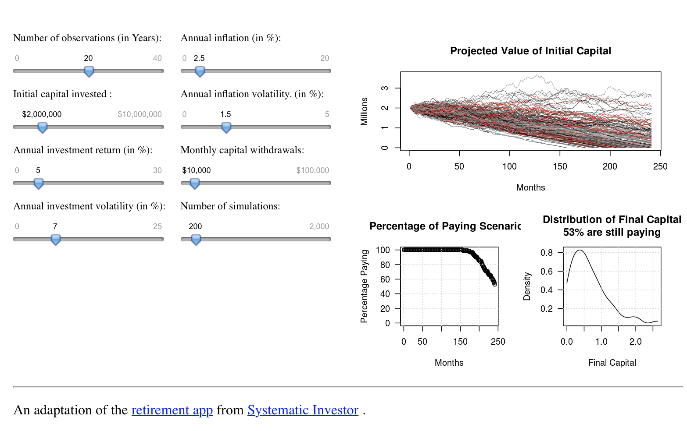
Enter Shiny
Interactive Web Application Framework for R
Expects no knowledge of web technologies like HTML, CSS, or JavaScript
(but you can leverage them, if you know them)

Slide 10
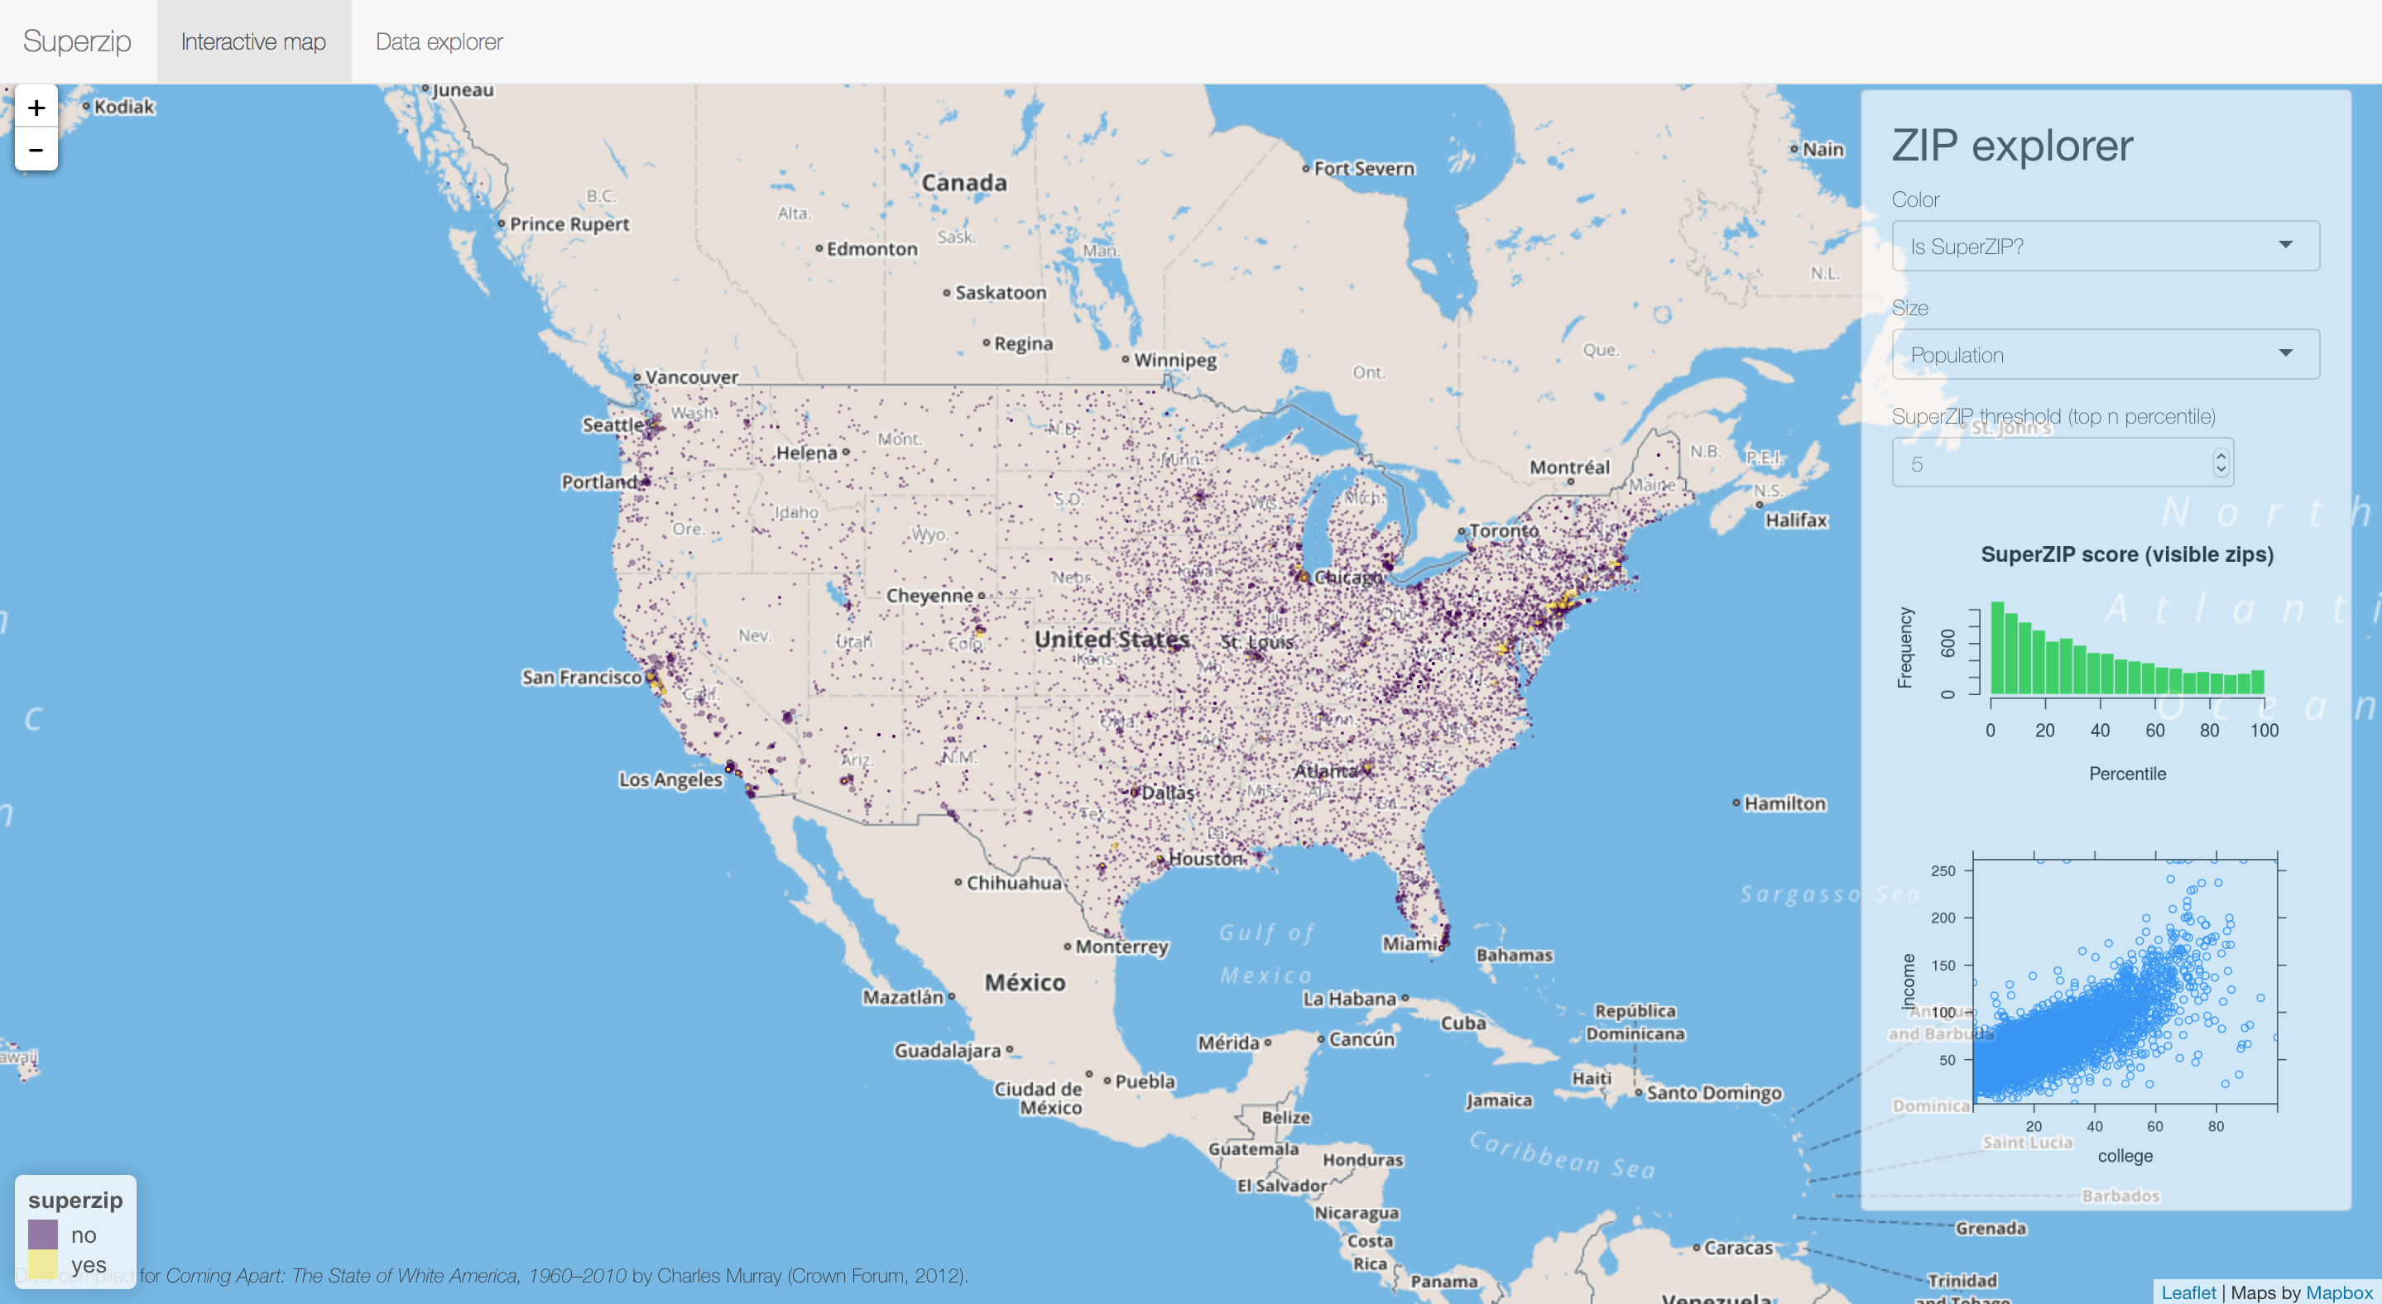
Powerful Examples

Slide 11
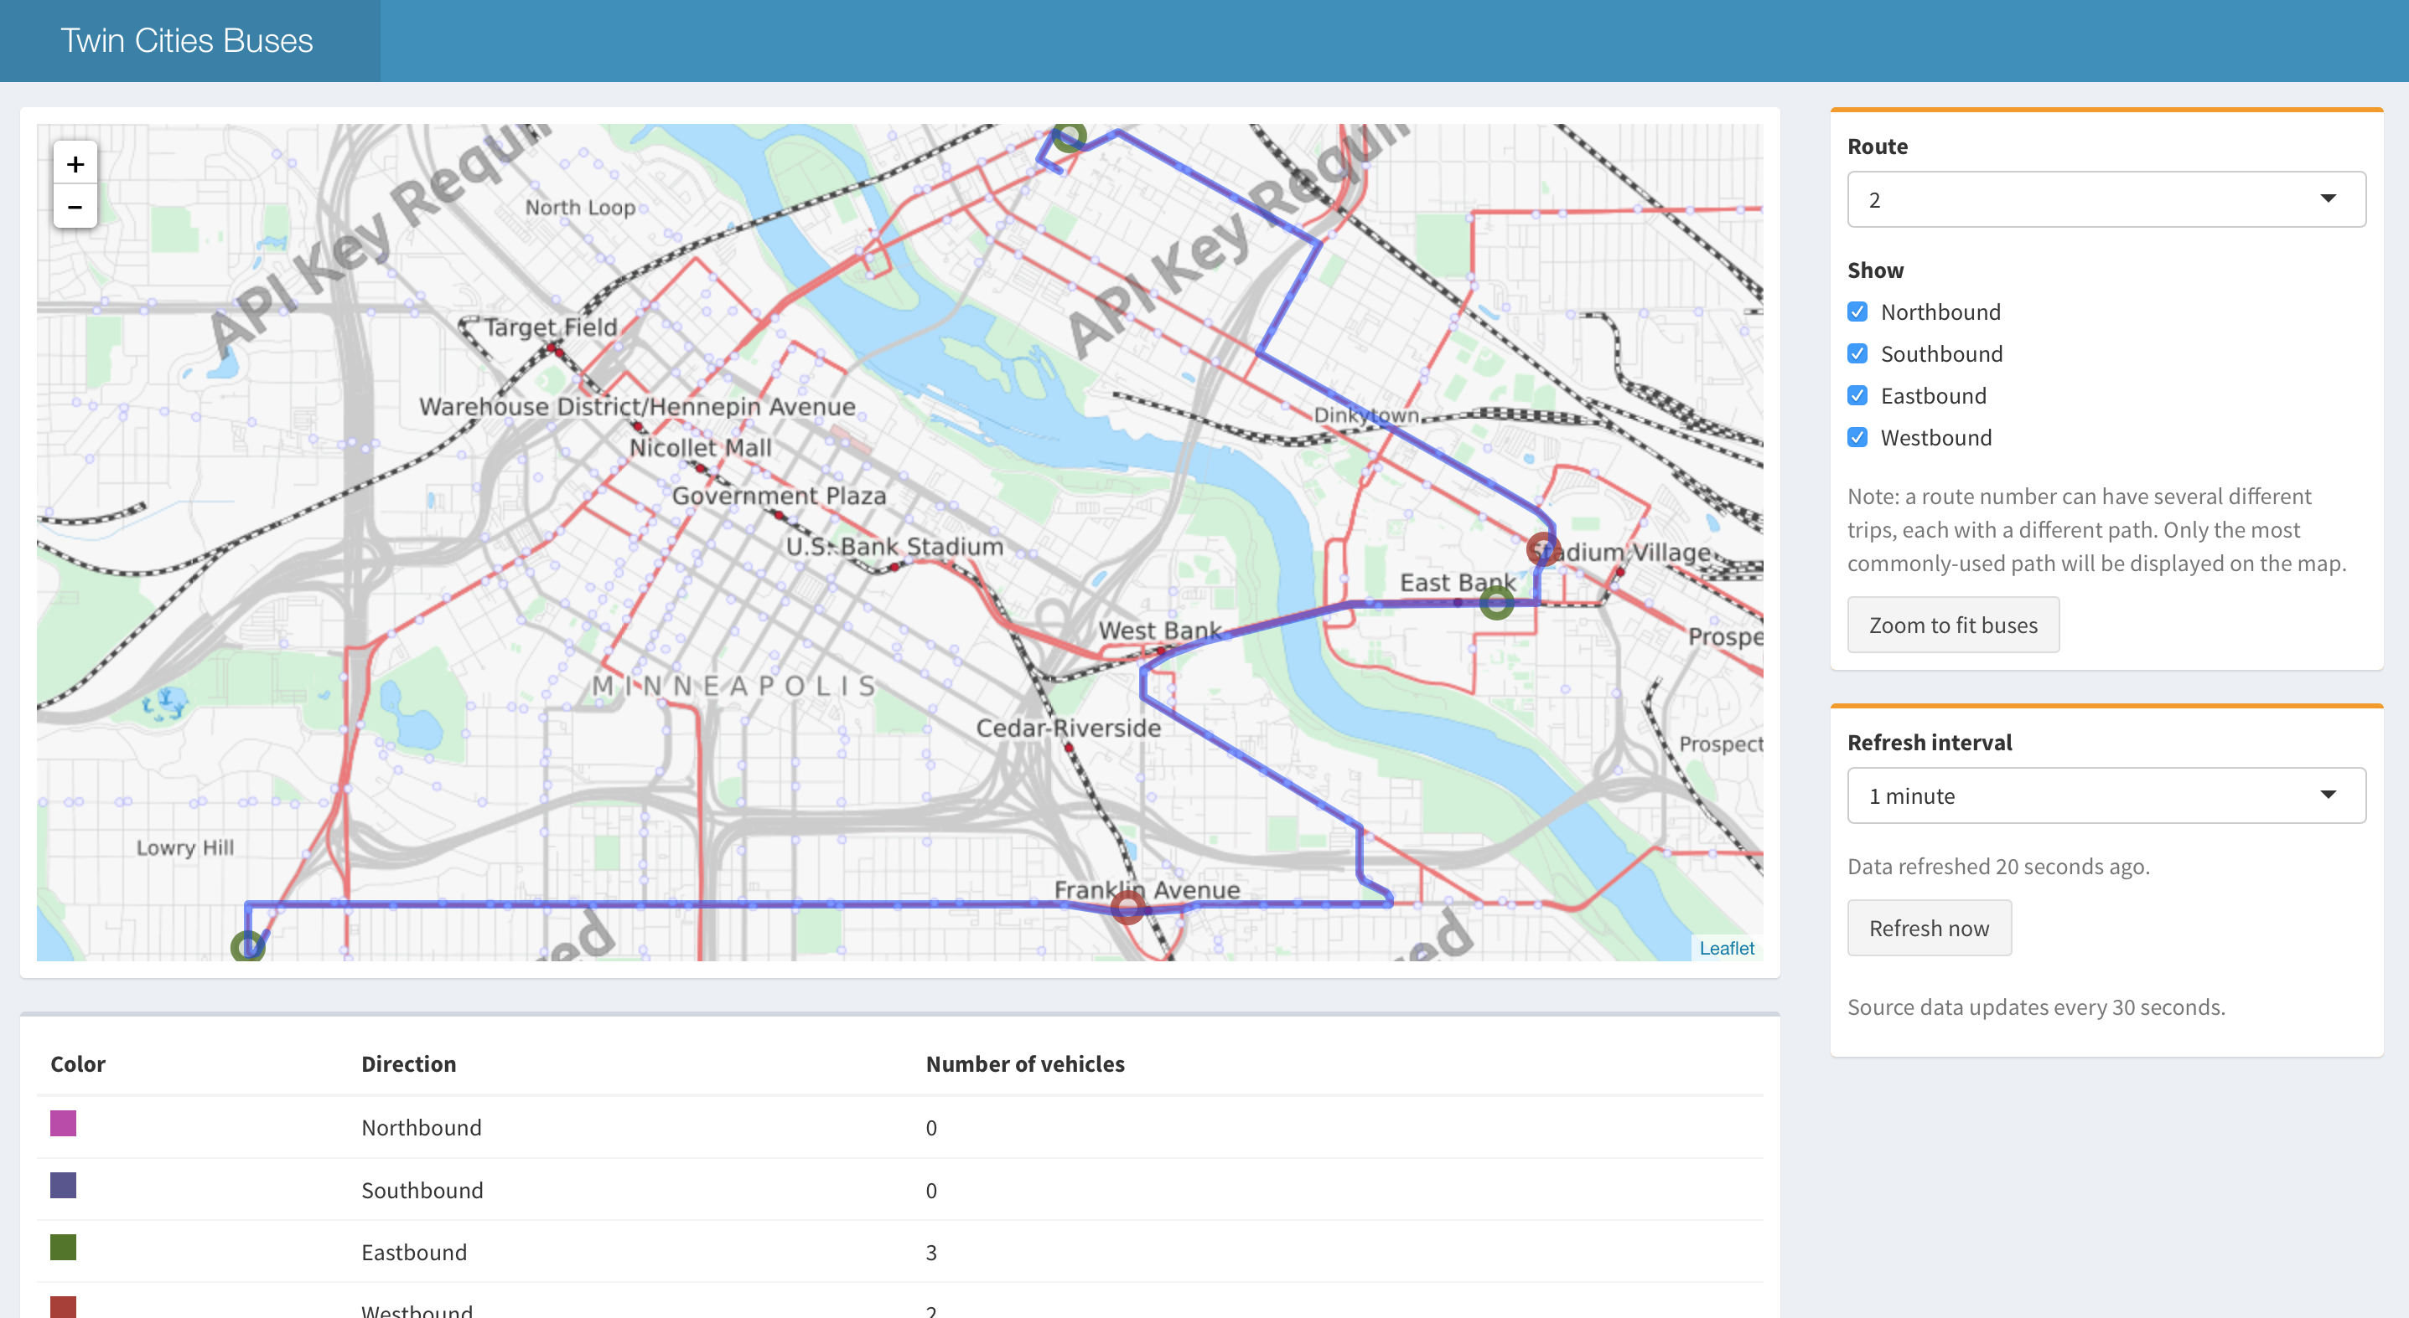
Powerful Examples

Slide 12
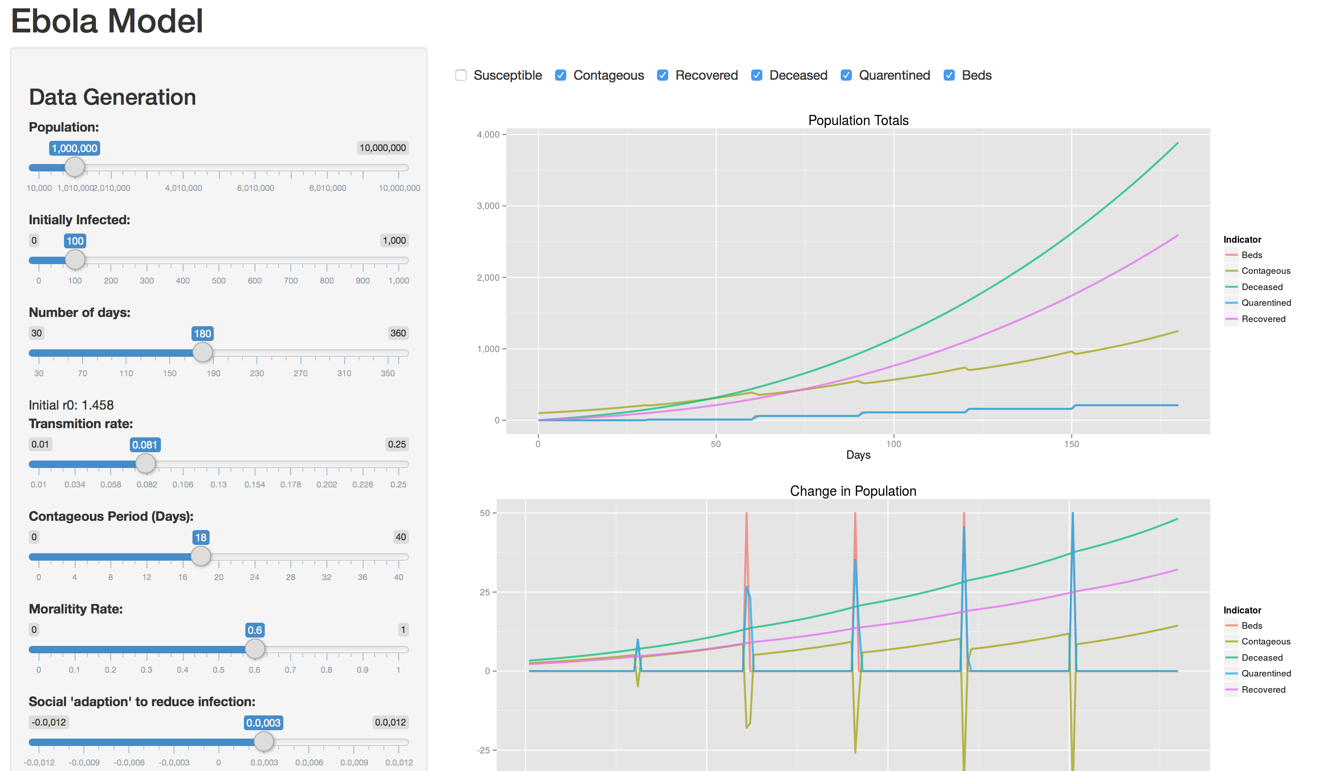
Powerful Examples

Slide 13
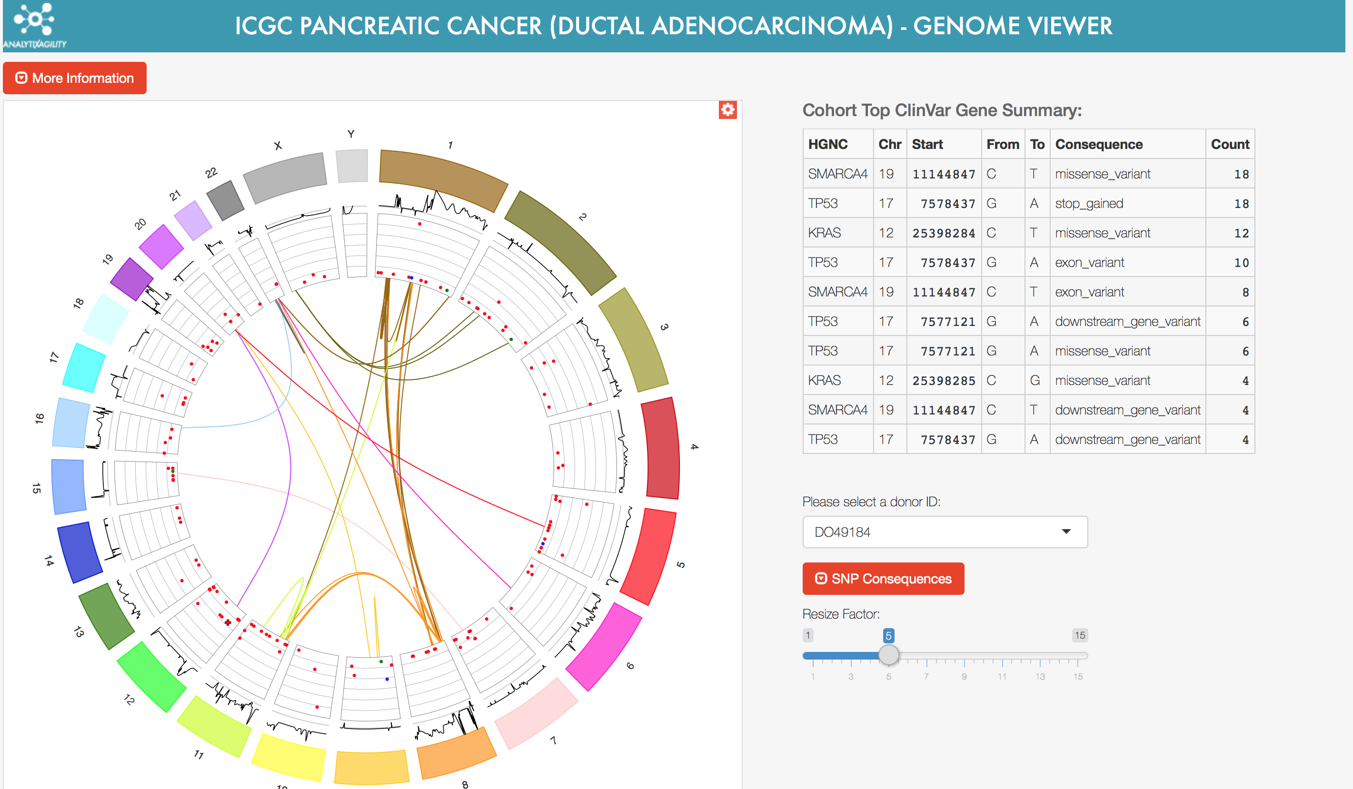
Powerful Examples

Slide 14
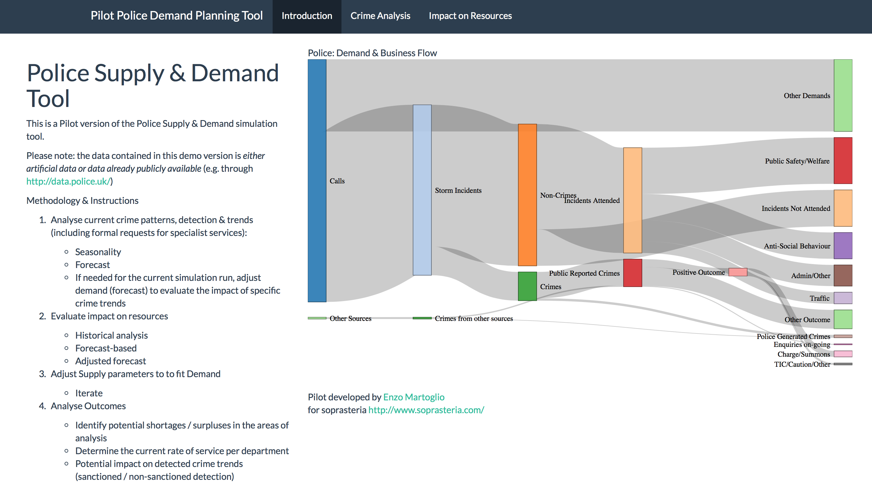
Powerful Examples

Slide 15
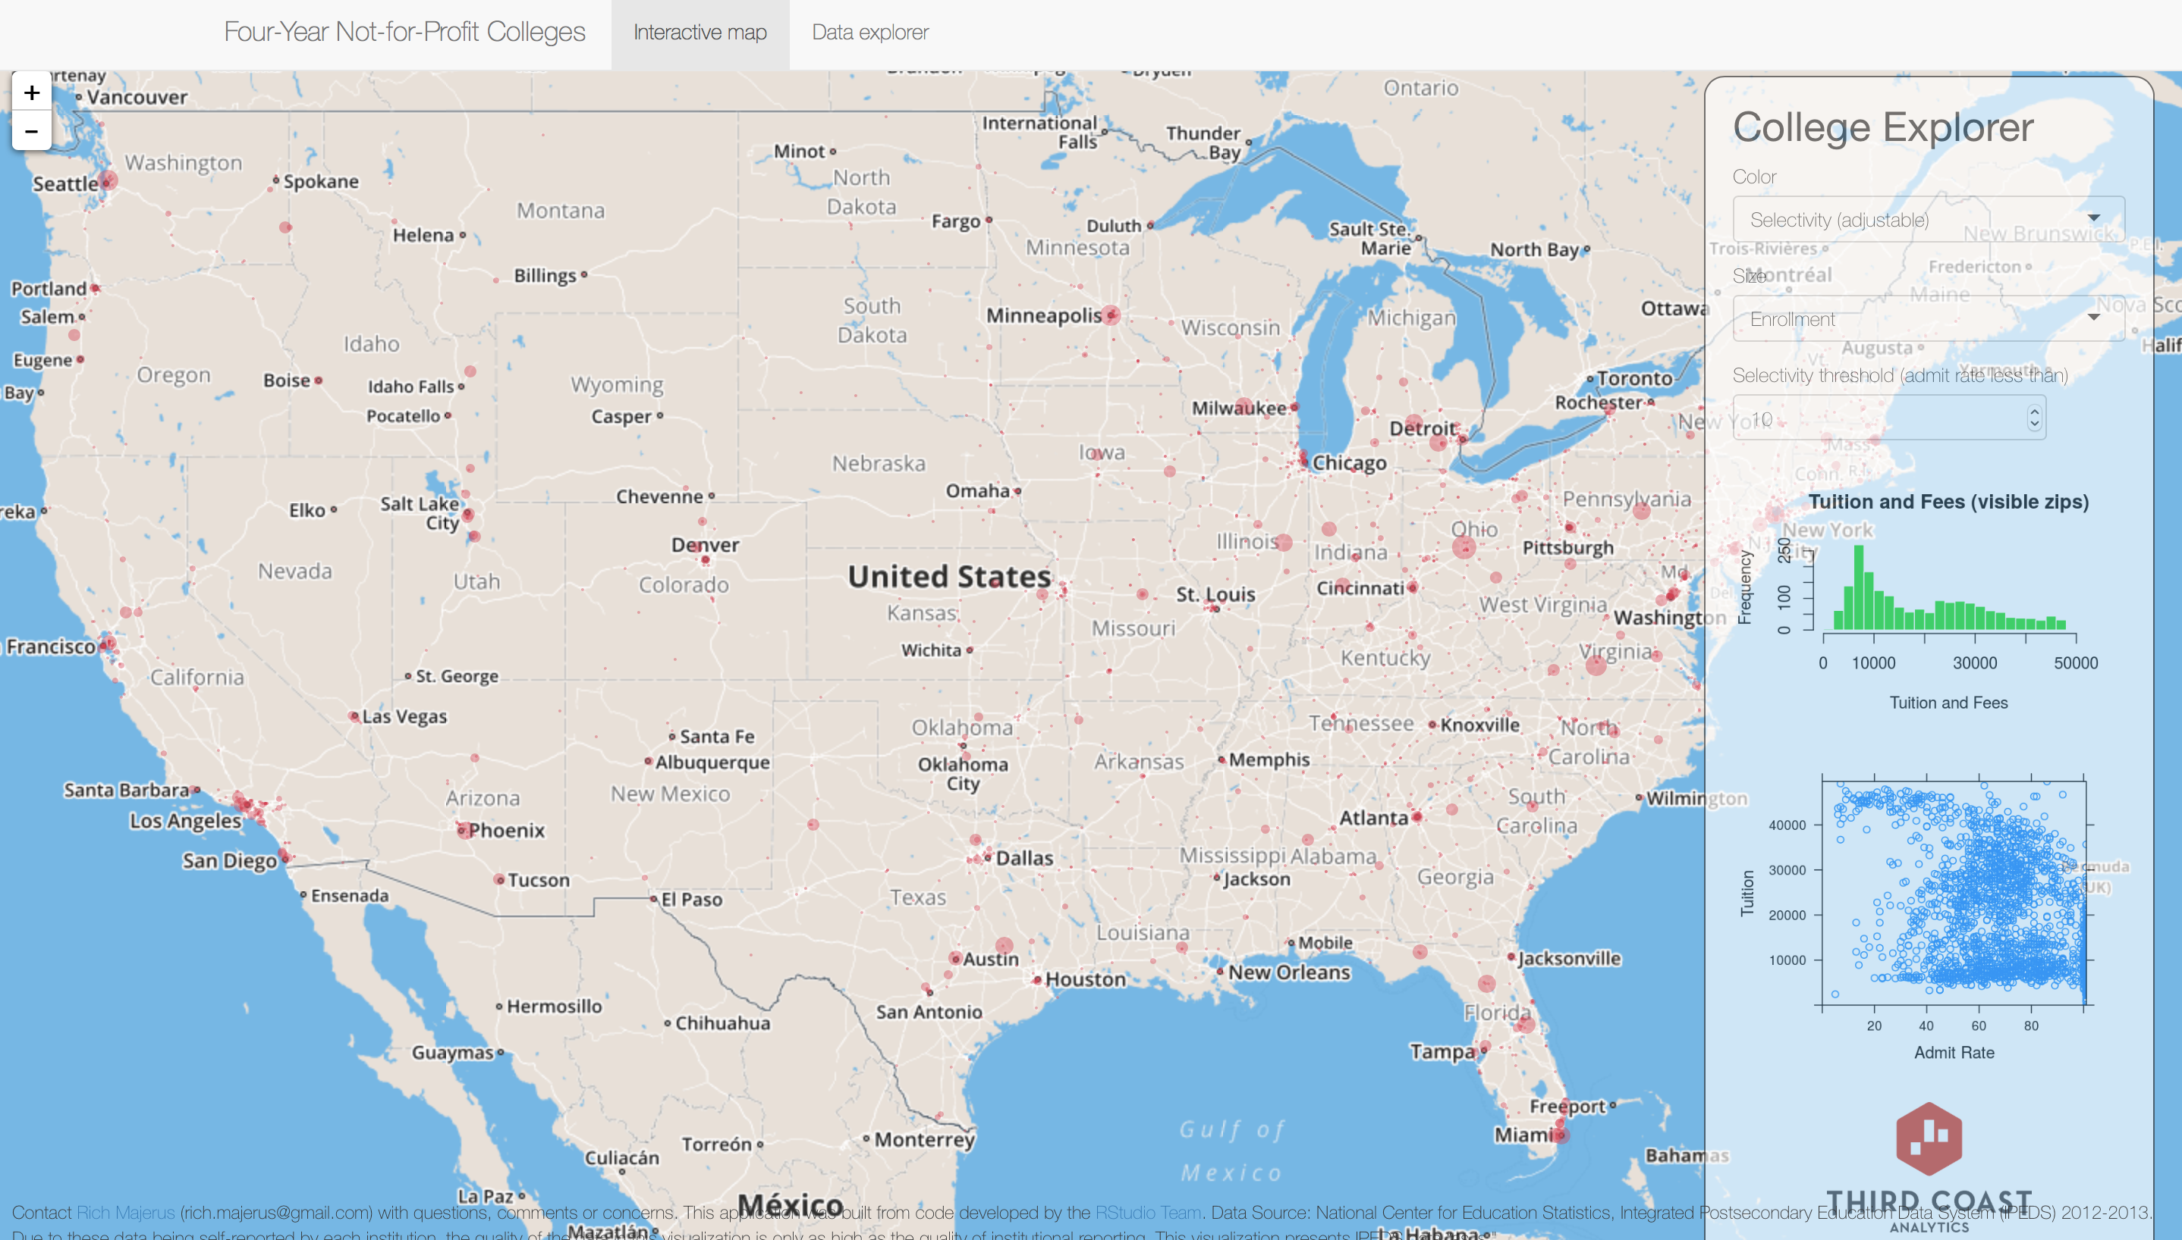
Powerful Examples

Slide 16
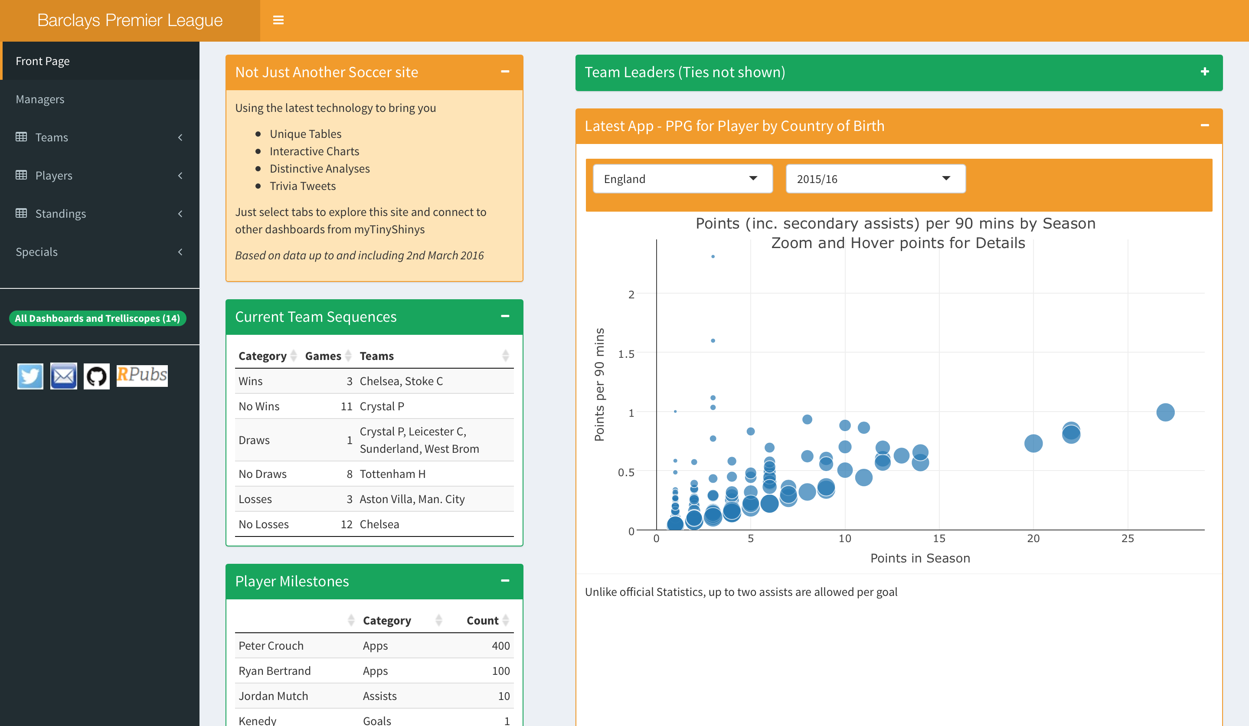
Powerful Examples

Slide 17
What is Shiny?

Slide 18
What is Shiny?

Slide 19
Create App: Method 1
All the components in one file
“app.R”

Slide 20
Create App: Method 2
Two files
“ui.R” & “server.R” in same directory
Good for complex apps
Separates View & Logic

Slide 21
Create App: Method 3
Generates the template for you

Slide 22
Adding Elements to UI
Add any HTML element

Slide 23
Using a layout in UI
This is a sidebarLayout()

Slide 24
Inputs & Outputs
Interactivity needs Inputs & Outputs
Inputs
User can play with
Outputs
Users can observe and often depend on inputs

Slide 25
Inputs

Slide 26
Inputs

Slide 27
Outputs

Slide 28
Outputs

Slide 29
Server
Server is the logic which transforms Inputs into Outputs
Saves the object into output UI element “myplot”
Gets the value from input UI element
“num”
render*() function builds the reactive output to display on UI

Slide 30
Render
Render Functions build reactive output to display in UI

Slide 31
Shiny – Lots more to explore
Shiny official tutorial http://shiny.rstudio.com/tutorial
Shiny cheatsheet http://shiny.rstudio.com/images/shiny-cheatsheet.pdf
Lots of short useful topics http://shiny.rstudio.com/articles
Shiny in Rmarkdown http://rmarkdown.rstudio.com/authoring_shiny.html
Publish your app free with RStudio http://www.shinyapps.io
Explore and learn from other Apps https://www.rstudio.com/products/shiny/shiny-user-showcase/

Slide 32
Shiny
Flights Demo

Slide 33
Shiny
Lunch Break

